Slide 1
Automated MVR System
Joe Dosch, Peter Fischbach, Keerthana Sadasivan, Sneha Shakya, Matthew Young

Slide 2
Business Needs
Features
Automate MVR Request
Streamline MVR Processing
User Friendly

Slide 3
MVR System Scope
A system that provides business records that assist business operations.
A system that records and maintains a database.
A web-based interface to submit applications.
A dynamic MVR request system.

Slide 4

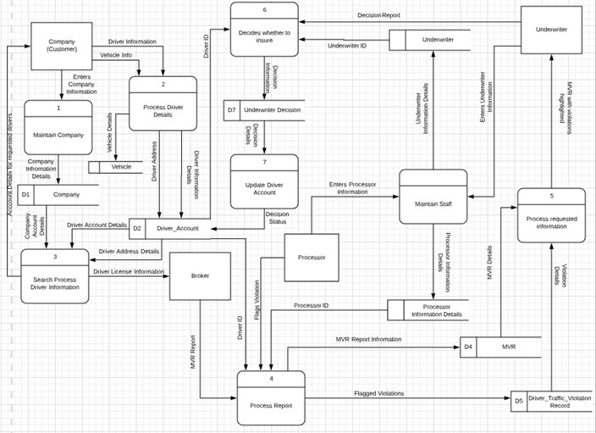

Slide 5
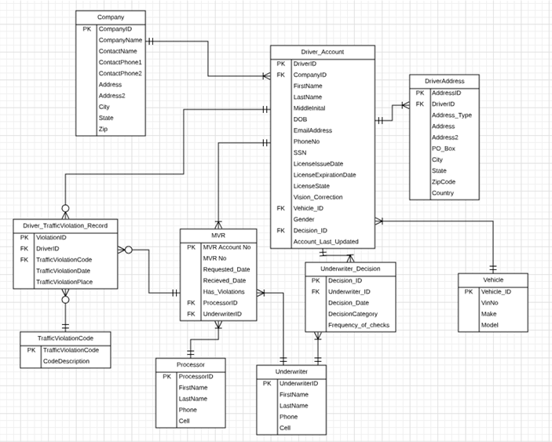

Slide 6
User Interface
Easy to navigate
Universal log-in page
Lists of drivers and companies

Slide 7
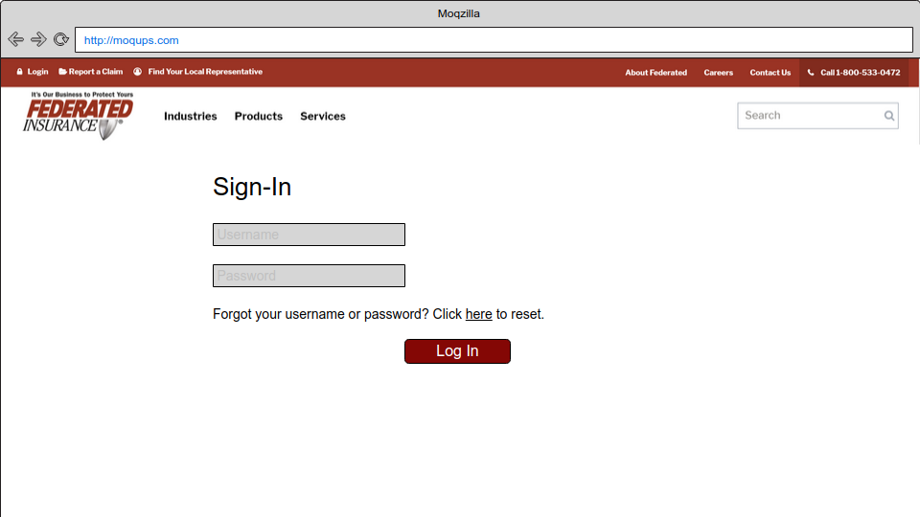
Universal Sign-In

Slide 8
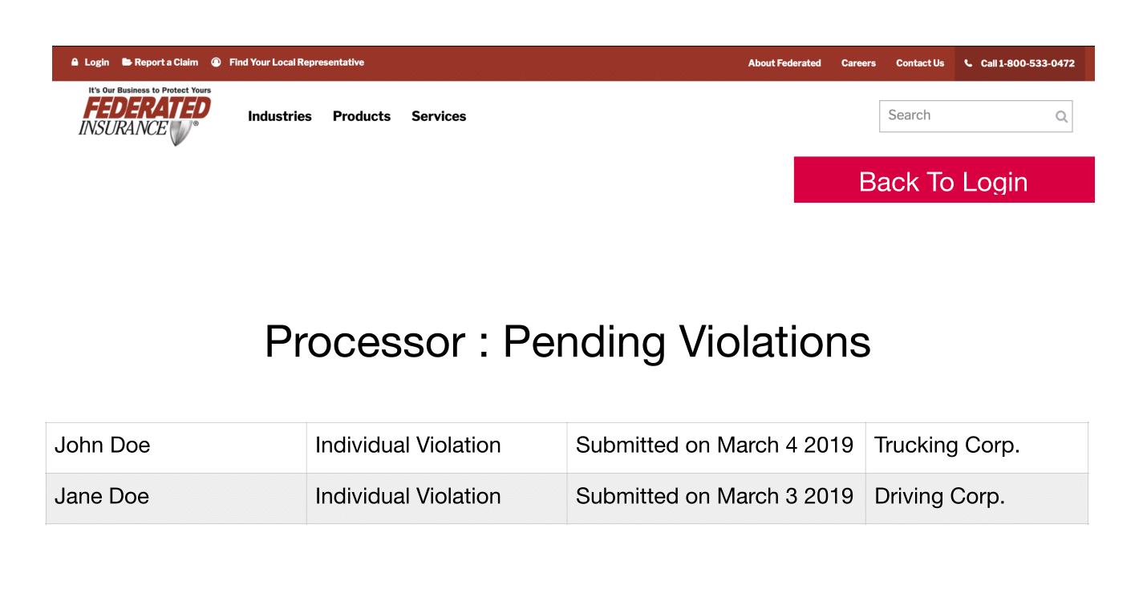
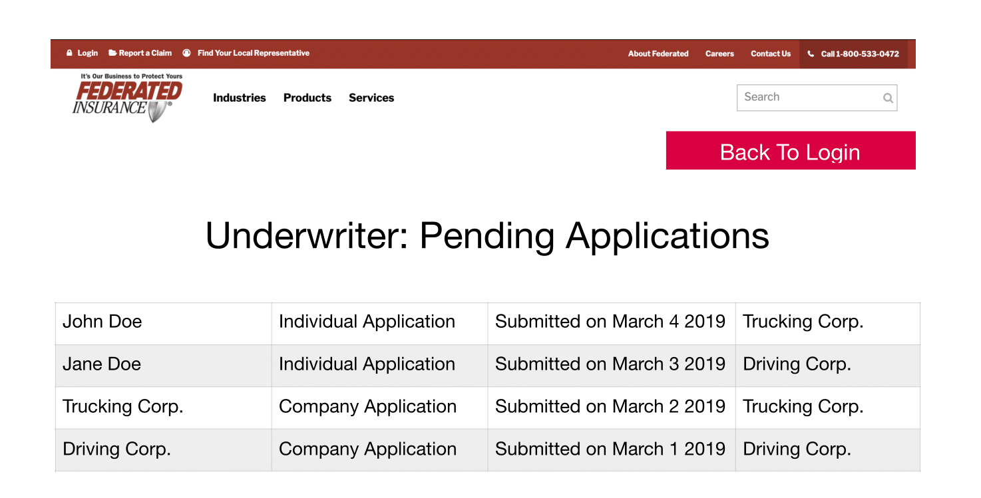
Pending Lists for Applications & Violations

Slide 9
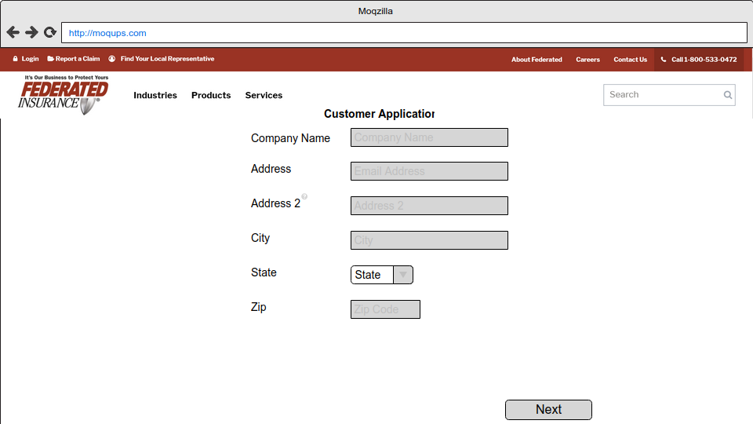
Company Application

Slide 10
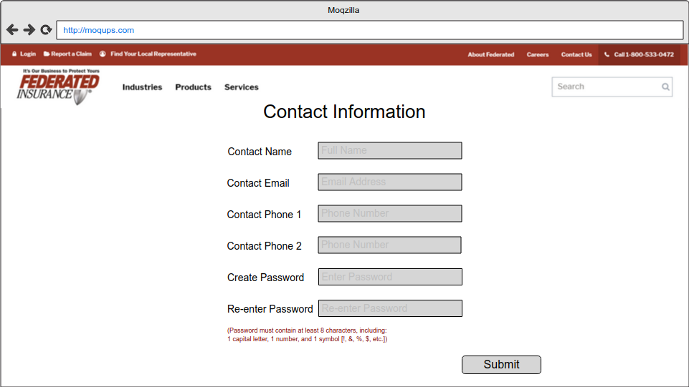
Company Application

Slide 11
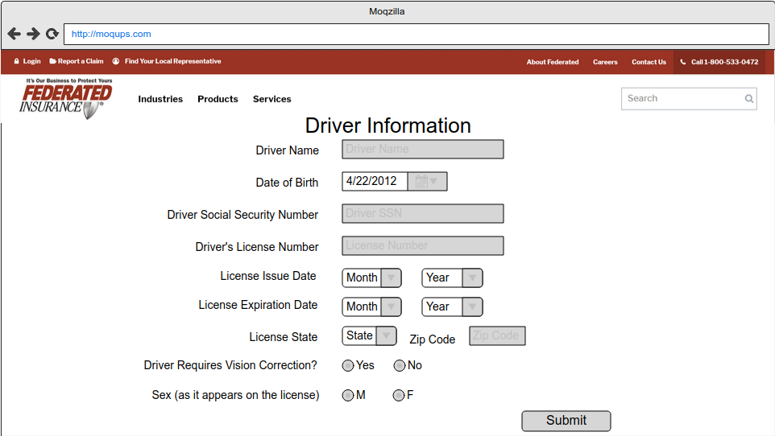
Driver Application

Slide 12
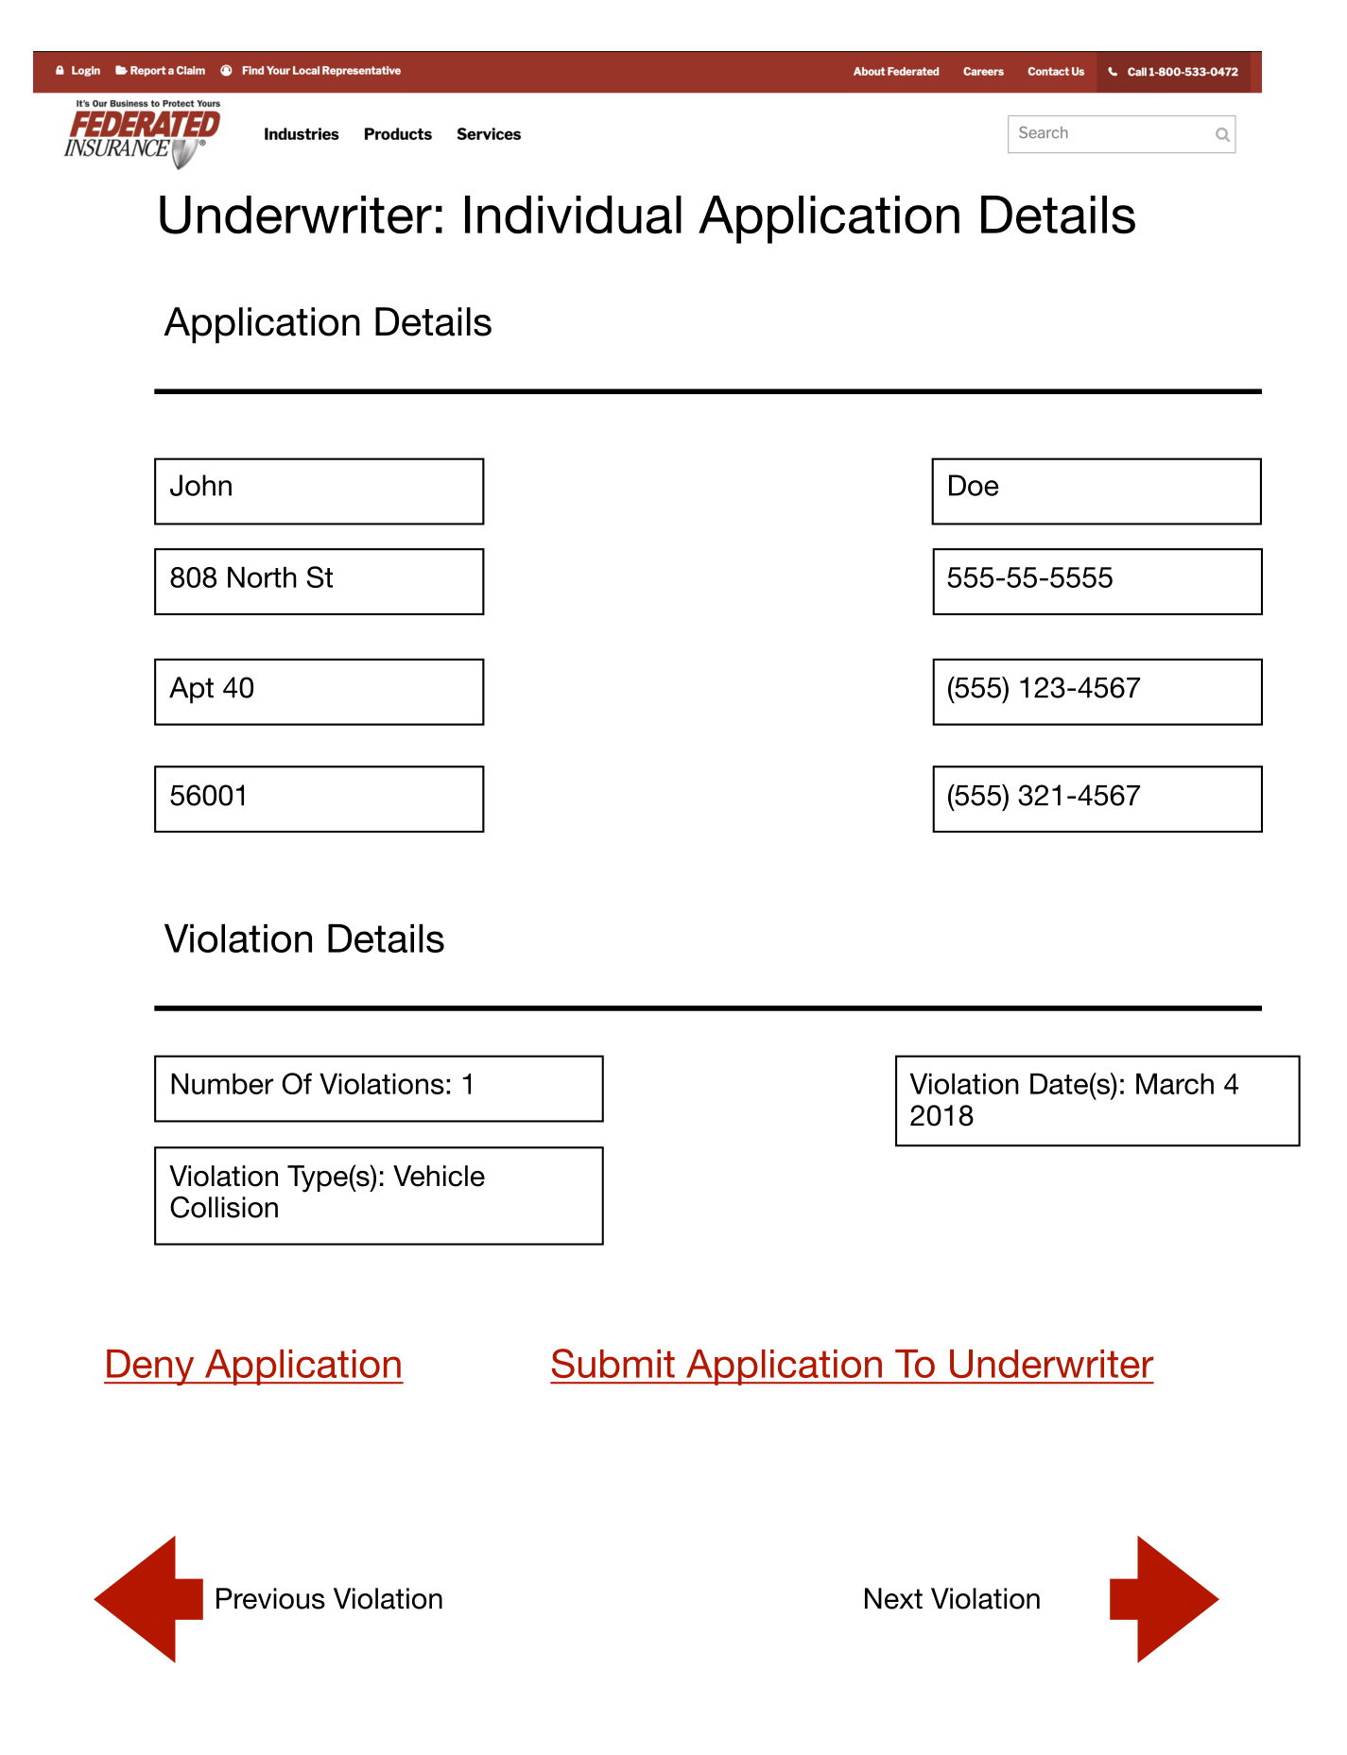
Application Detail Reviews

Slide 13
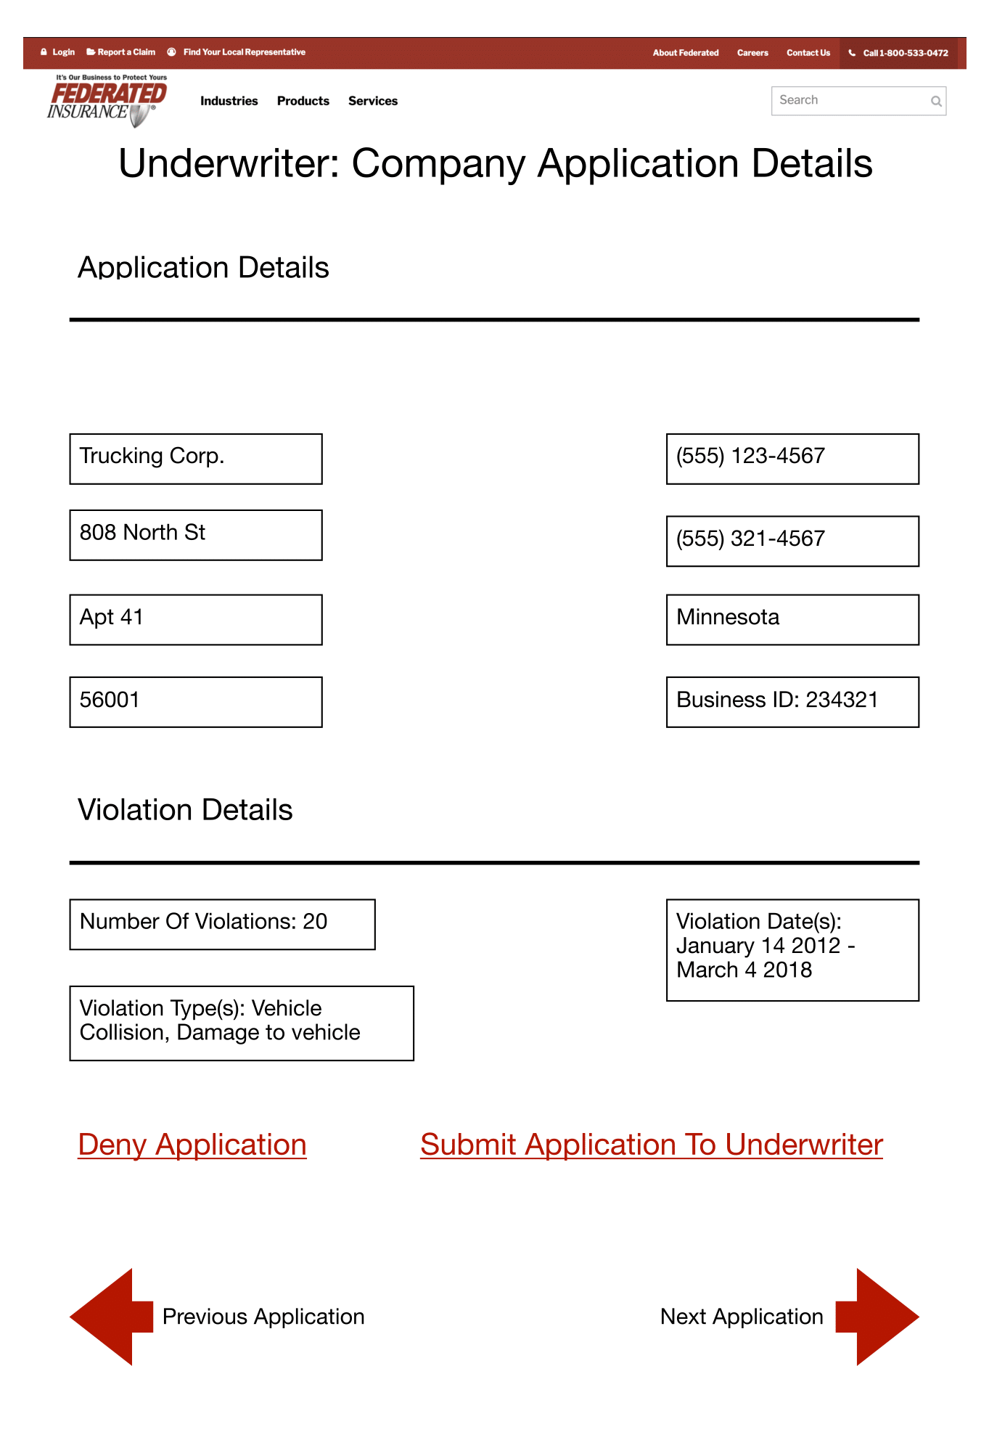
Application Detail Reviews

Slide 14
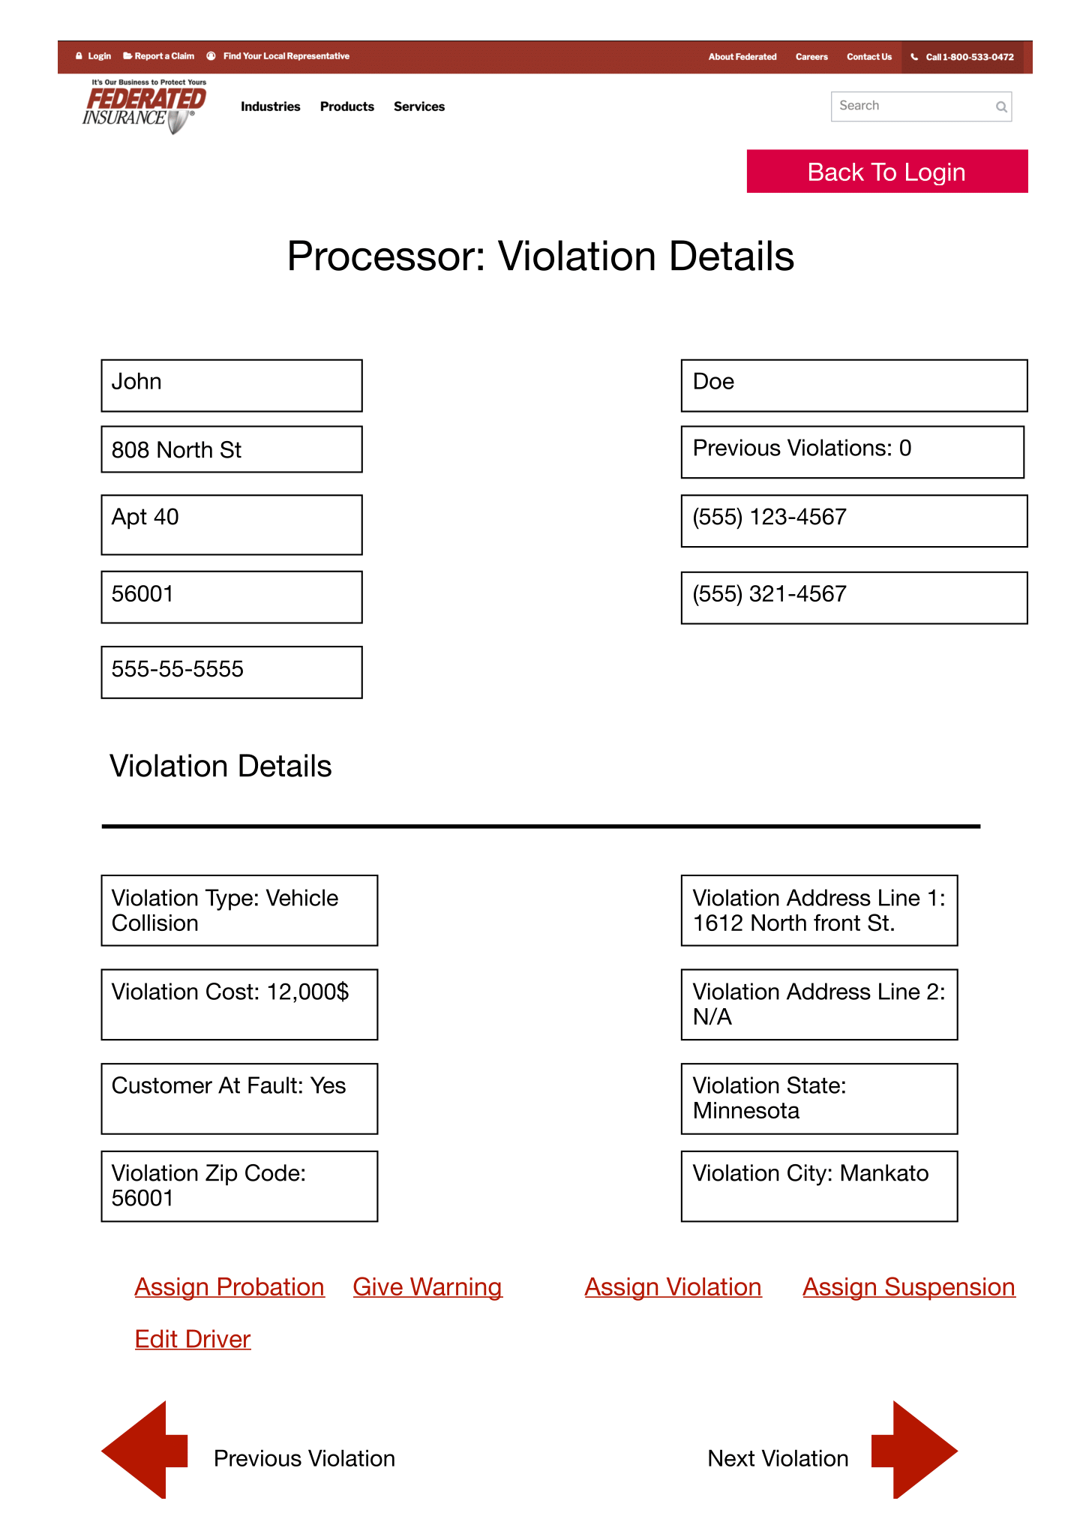
Violation Reviews

Slide 15
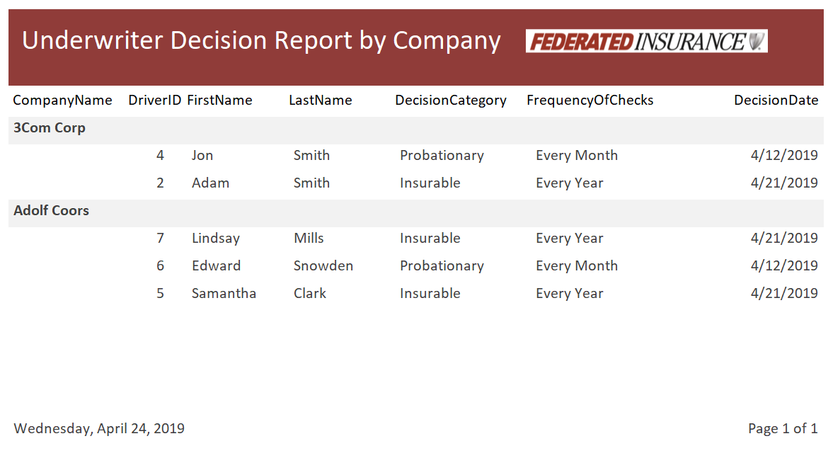

Slide 16
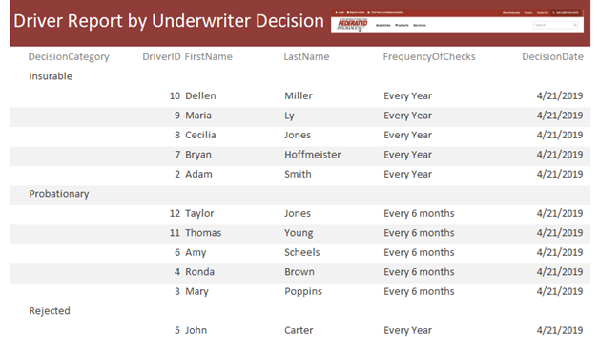

Slide 17
Types of Forms
Company Application Form
Driver Application Form

Slide 18
Review of Proposal
Graphically simple, but classic
Easy to use makes it easier to maintain
Lots of functionality for all types of users
Extensive back-end design

Slide 19
LIVE DEMONSTRATION

Slide 20
Thank You For Your Time
Questions/Comments?

